Slide 1
Minor Actinide Bearing Metallic Fuels
Mahmoud Hawary
NE 795 – Fall 2021

Slide 2
Outline
Introduction
MA Transmutation
Why Metallic Fuels?
Fabrication Process
Injection Casting
Arc Melting
Irradiation Test Results
X501
AFC-1

Slide 3
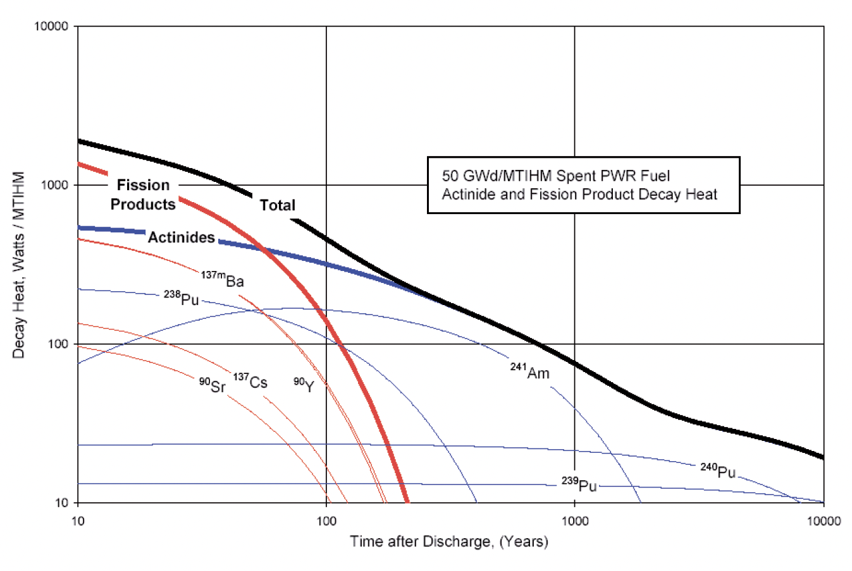
Introduction
Transuranic (TRU) are responsible for a significant fraction of the long-term radiation and decay heat of spent fuel which can be extended to several thousands or even million years.
The main contributors:
Pu (1% of spent fuel)
Actinides (americium, curium, and neptunium) (~0.07% of spent fuel)
FPs (Cs-135, Tc-99, I-129) (~4% of spent fuel)
Some TRU isotopes, such as Pu-239, represent a proliferation risk.
Pu → recycled in PWRs as MOX fuel.
FPs and MA → vitrified and waiting for a geological repository.
Activated metallic structure → compacted and stored on surface
Separate the most radiotoxic and long-lived elements from spent fuel and transmute them into short-lived or non-reactive ones in a nuclear reactor.
Notes:
Figure 2 shows that after an approximately 80 year cooling time, the heat generation rate in LWR spent fuel irradiated to 50 GWd/t is dominated by actinides, in particular 241Am.
The heat generation rate remains above 100 watts per tonne of heavy metal for approximately 900 years after discharge. This high, long term heat load will likely limit repository loading for scenarios planned in many countries due to potentially undesirable microstructural and chemical changes in drift wall materials. Thus, removing actinides from the waste stream could potentially increase repository space utilization by a large factor

Slide 4
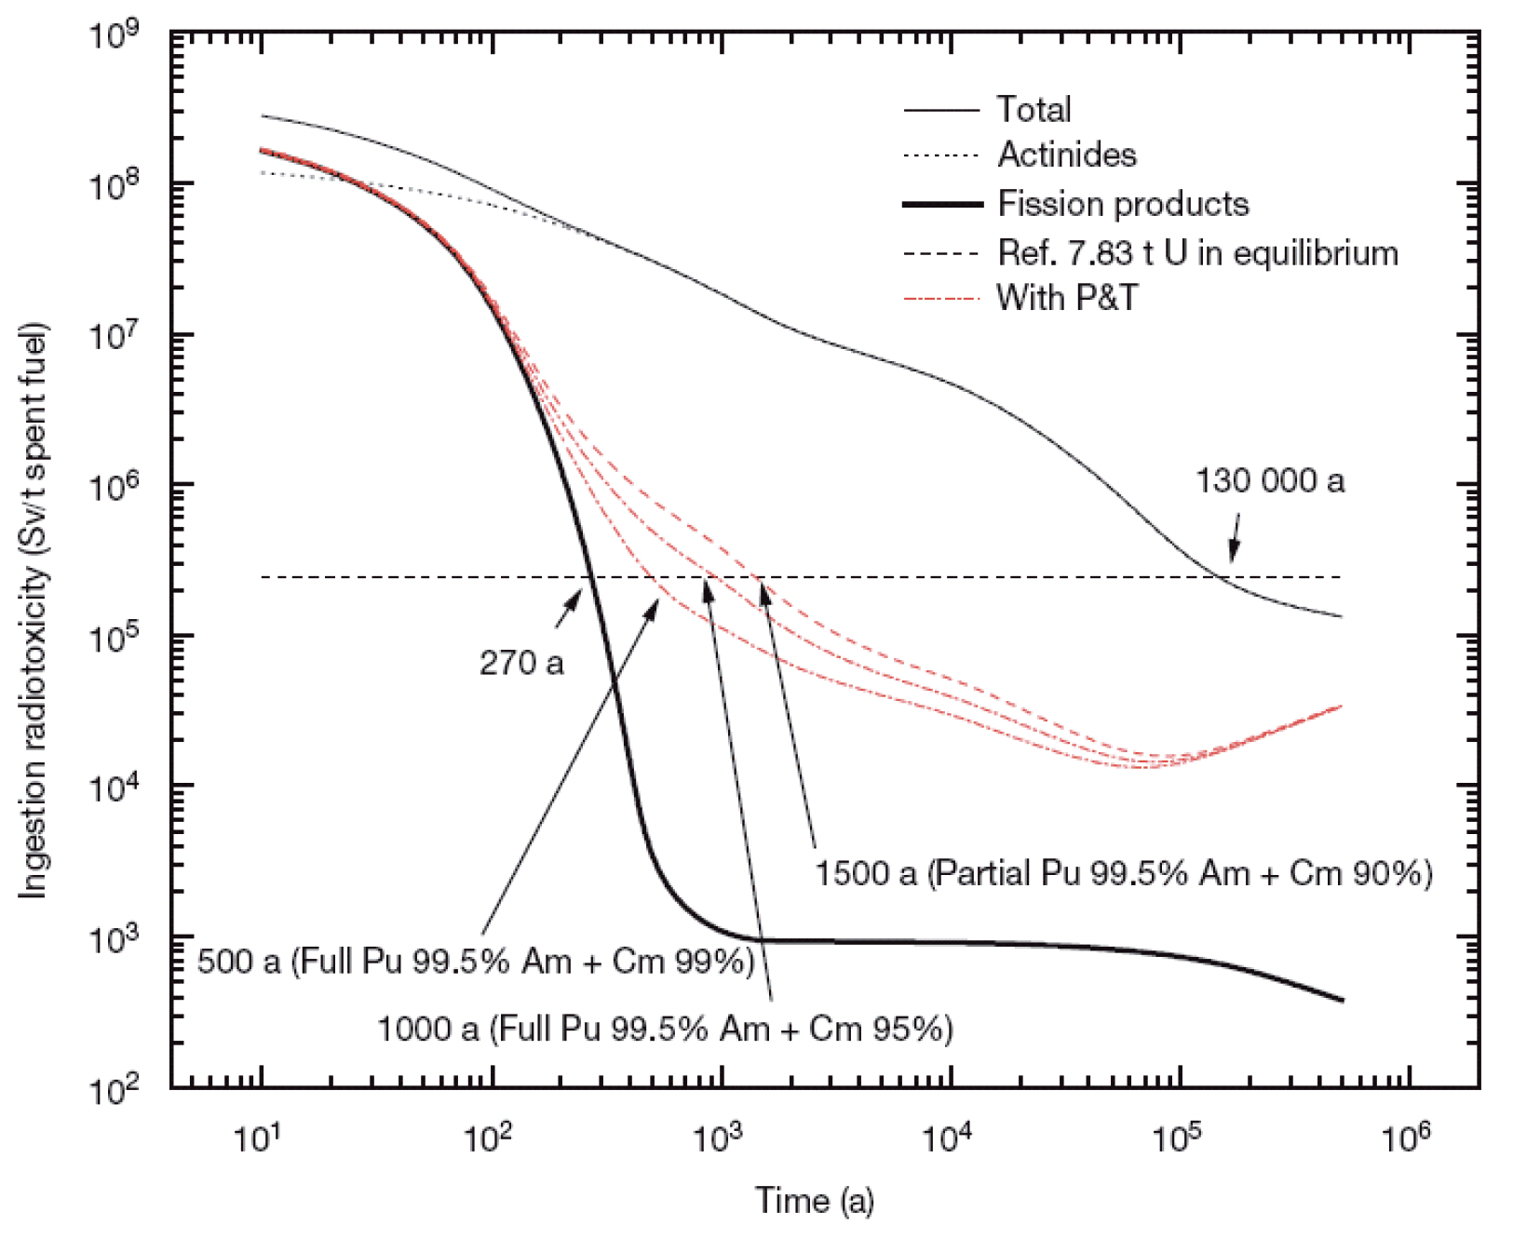
MA Transmutation
Benefits of partitioning and transmutation:
Minimize radioactive waste destined for repositories;
Increase the operating safety of nuclear energy systems;
Enhance proliferation resistance of the nuclear fuel cycle;
Increase the efficiency of natural resource utilization;
Decrease required repository space;
Increase the economic competitiveness of nuclear power plants.

Slide 5
MA Transmutation
All types of nuclear reactors do not provide the same transmutation potential and on the other hand that all radionuclides cannot be efficiently transmuted.
The best transmutation performance is obtained in the fast neutron reactor (FR).
Transmutation is only reasonably applicable for MAs, chiefly americium, neptunium, and curium.
Transmutation of MAs cannot take place unless they have been individually, or as a group, separated from the spent fuel.
Transmutation of MA can occur in two major fast reactor families:
Sodium-cooled (SFRs) or Gas-cooled (GFRs) fast reactors;
Subcritical hybrid reactors driven by an accelerator (ADS) cooled with lead or lead bismuth.
The content and throughput of minor actinides in a transmutation system can be limited by:
Reactor safety → deterioration of neutronic characteristics of the reactor core
Chemical processing
fuel performance issues → helium generation due to α-decays → enhances swelling.

Slide 6
Why Metallic Fuel?
General requirements for MA containing fuel:
Must be fabricated using remote processes and in hot cell environments → leave residual of FPs.
Must be compatible with fuel recycling process.
Must provide robust containment of FPs for safety issues.
Should consider the volatilization of americium → loss or redistribution during fabrication.
Metal alloy transmutation fuels are of interest primarily for closed fuel cycle fast spectrum systems when coupled to an electrorefining based pyroprocessing, due to the potential for a compact integral reactor/recycle system → the main reason of interesting.
In metallic fuel:
High swelling behavior → fuel with a sodium filled fuel to cladding gap.
High FGR → Increase the gas plenum.
Helium generation due to americium and curium is a matter of:
sizing the gas plenum to prevent excessive gas pressure driven cladding creep;
ensuring that gap size is adequate to accommodate solid fission product swelling.
Remote fabrication was established as part of the EBR-II development program in the 1960s with the remote fabrication of more than 39 000 fuel pins in a hot cell.

Slide 7
Why Metallic Fuel?
Metal fuels may be used as:
Fertile fuels
Inert matrix fuels (IMFs):
Advantages of IMFs:
Provides higher burnup;
Pu-Zr has a well characterized phase diagram;
Adding Zr as an alloying agent limits the FCI and increase the melting point;
Disadvantages of IMFs:
U-Pu-Am-Np-Cm-Zr alloys have incomplete knowledge of the the phase equilibria.
Formation of low melting phases due to an inhomogeneous microstructure.
Notes:
IMF : fuel containing a low activation matrix as a carrier for the fissile material

Slide 8
Fabrication Processes
Injection Casting:
Utilizes differential pressure to drive molten fuel alloys into molds, where the metal is rapidly solidified.
EBR-II experimental fuel pins for the X501 MA transmutation experiment were fabricated in this way.
A considerable amount of Am is lost in the injection casting process → volatilization of Ca and Mg impurities (exist in the Am feedstock).
Notes:
IMF : fuel containing a low activation matrix as a carrier for the fissile material

Slide 9
Fabrication Processes
2. Arc casting:
U–Pu–MA–Zr alloys were prepared by arc melting in an argon atmosphere.
To homogenize the alloys, U–Pu–MA alloy was first prepared by arc melting and then molten Zr was added.
Some rapid melting techniques (gravity drop method) have been developed to reduce the loss of volatile americium during the fabrication.
Although successful for fabrication of laboratory scale, it is not intended for scale-up.
Notes:
IMF : fuel containing a low activation matrix as a carrier for the fissile material

Slide 10
Irradiation Tests
X501:
Conducted in the EBR-II reactor as part of Fast Reactor (IFR) program.
Assembly contains two metallic fuel pins loaded with relatively small quantities of americium and neptunium.
The X501 assembly was inserted into the EBR-II in February 1993 and withdrawn in September 1994:
Total irradiation time = 339 effective full power days
Burnup = 7.6%
Peak fuel centerline temp = 700 ºC
Peak inner cladding surface temp = 540 ºC
Transmutation of Am-241 = 9.1%

Slide 11
Irradiation Tests
X501 PIE Results:
Normal metallic fuel fission product behavior;
No evidence of reaction layer formation on the inner cladding wall or the outer surface of the fuel slug;
A gap was visible between fuel and the cladding wall at all locations;
Microstructure typical of U-20Pu-10Zr → three microstructural zones within the fuel:
Outer zone: enriched with Zr;
Intermediate zone: Zr depleted;
Central zone: Zr enriched and U depleted;
Plutonium content remained relatively uniform;
Americium appeared in the form of features with high elemental concentrations, generally depleted in U, Pu, and Zr → it’s suggested that these features formed during irradiation.
Am present only in uranium depleted central and outer zones → Am migration had occurred;
90% of the helium gas produced was released to the plenum → 79% is typical for U–Pu–Zr fuel.

Slide 12
Irradiation Tests
AFC-1:
AFC-1B and AFC-1F irradiation test → intermediate burnups of 4 to 8 at.% on nonfertile and fertile actinide transmutation fuel forms containing Pu, Np, and Am.
The AFC-1B test capsule → Pu-12Am-40Zr and Pu-10Am-10Np-40Zr.
The AFC-1F test capsule → U-28Pu-4Am-2Np-30Zr, U-27Pu-3Am-2Np-40Zr, U-34Pu-4Am-2Np-20Zr, and U-29Pu-7Am.
AFC fuel test hardware was designed to simulate fast reactor test conditions in INL’s ATR.
Fuels were sodium bonded inside stainless steel Type 421 (HT-9) cladding with an inert plenum gas.
AFC-1 PIE results:
FGR behavior similar to U-xPu-10Zr fuel.
No difference noted in fission gas release behavior between non-fertile (non-uranium bearing) and low fertile (uranium bearing) compositions.
Microstructures of fuels with high minor actinide contents to those for U–Pu–Zr fuel indicate similar microscopic and swelling characteristics at equivalent fission densities.

Slide 13
Questions!

Slide 14
Backup Slides

Slide 15
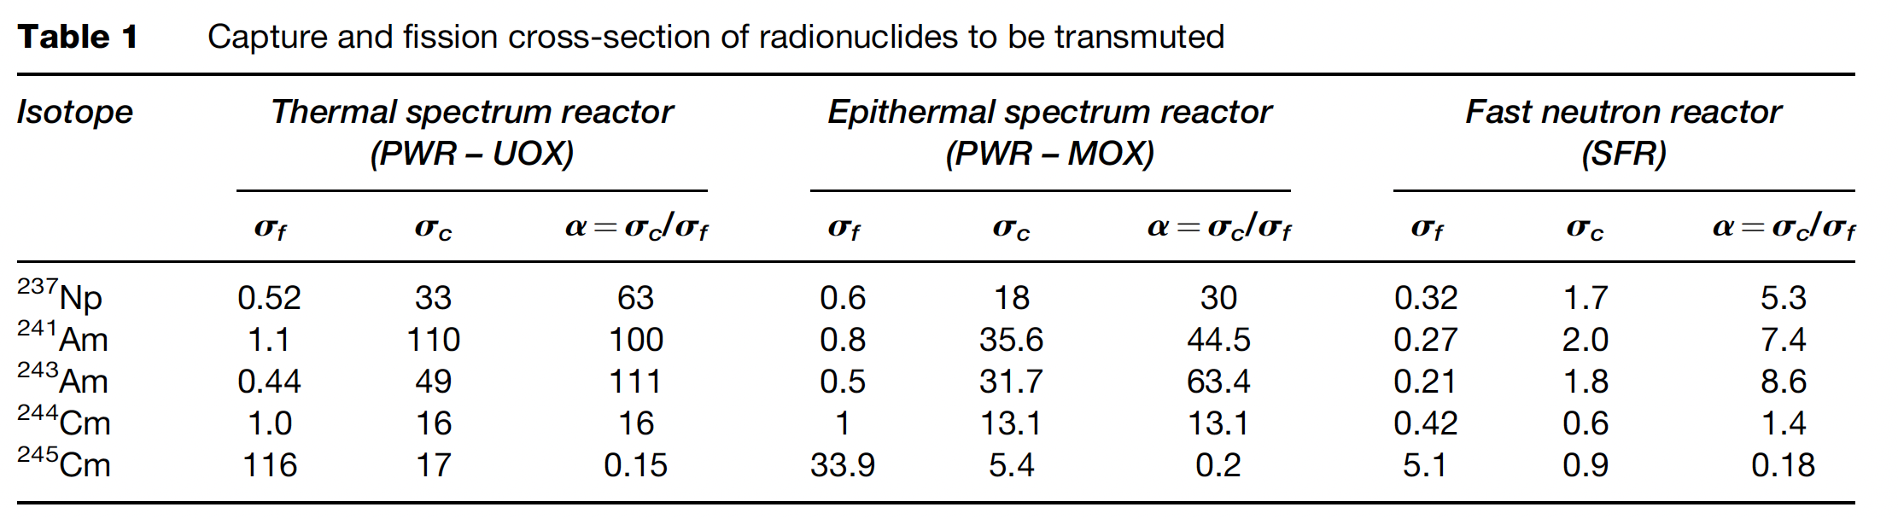
Table 1 gives the average efficient cross-sections of capture sc and fission sf for each radionuclide, as well as the a ratio of these cross-sections for three characteristic neutron spectra: a PWR spectrum with UOX fuel, a PWR spectrum with MOX fuel, and a FR spectrum. The a ratio indicates the probabilities of disappearance by capture (section sc) rather than by fission (section sf) at the first neutron interaction.
Note that it is reduced by a factor of 5 at least for most radionuclides when we move from the neutron spectrum of a PWR (thermal or epithermal) to that <of the FR.

Slide 16
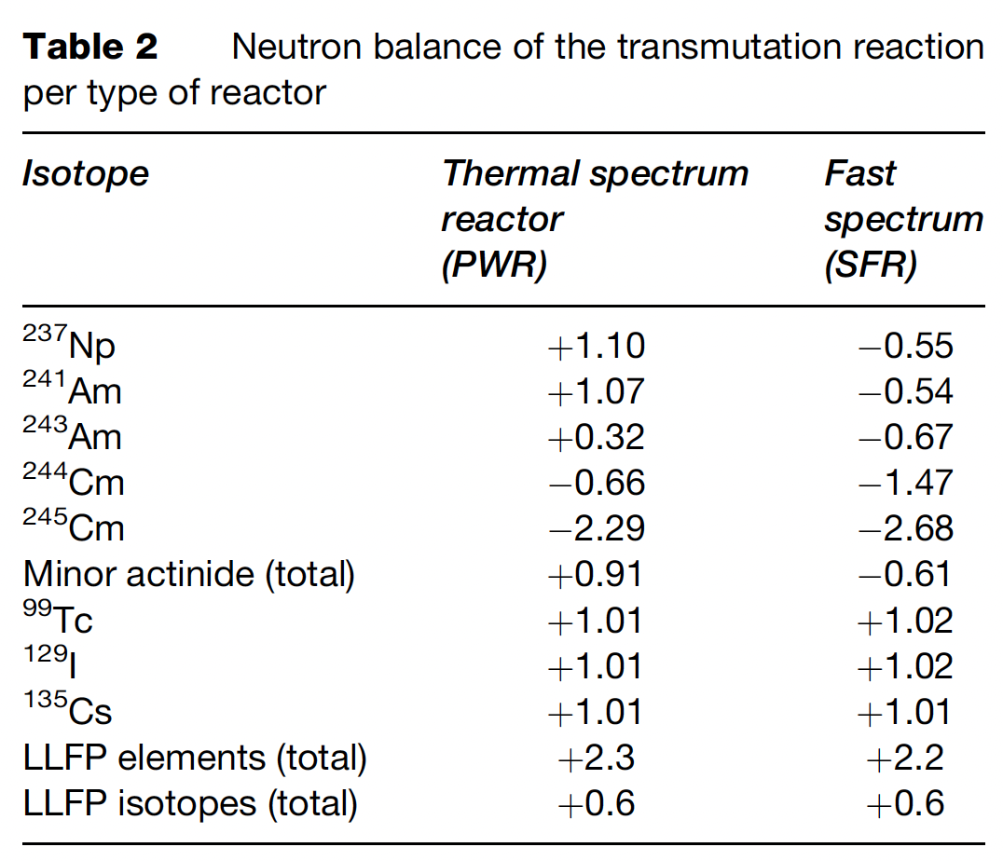
Table 2 shows the neutron balance of transmutation reaction for the main actinides per spectrum type. A positive balance corresponds to a net consumption of neutrons per transmutation reaction, whereas a negative balance corresponds to a production of excess neutrons.
Both tables show that the FR spectrum offers better conditions for transmutation by fission than the PWR thermal spectrum, which, combined with the fact that an FR flux is generally 10 times higher than that of a PWR, makes the FR a better candidate for transmutation. MAs notably contribute to the neutron balance and to maintaining the chain reaction in FRs whereas they poison the core of PWRs. Transmutation of FPs is costly in the thermal spectrum as well as in the fast spectrum as they are net consumers of neutrons.

